Slide 1
UXD PROJECT
GANPAT UNIVERSITY

Slide 2
TEAMMATES
YUORAJ
KAUSHLENDRA SINGH
JAY KUAMAR

Slide 3
Online Crime Reporting System
Online Crime Reporting System is an internet-based Project developed using PHP and MySQL. The Online Crime Reporting System will aim to create a web-based program using which people can report crime online. It gives the facility of uploading videos or images of crime scenes to ensure that authorities can take action immediately.
My engineering project gives you a Crime Reporting System project is to develop a web-based program using which people can report crime online. It provides the facility of uploading images or videos of crime scenes to ensure that police may take action immediately. It also supplies the advice of missing persons, most wanted criminals and security tips for the awareness of people.

Slide 4
ADVANTAGES:-
This web application allows the user to deal with the great ease of the environment.
It allows the user to complain of his crime anytime.
It provides the functionality to complain.
It also allows the user to change the password.
The users get a reply from admin.

Slide 5
Types of Cyber Crimes
Hacking
Theft
Cyber Stalking
illegal downloading
Identity Theft
Child Pornography
Computer Viruses and other Malware
Spamming

Slide 6

Cyber Crime Prevention Tips
Protect your Data and take backup of your data in duration
Use Strong Passwords
Secure your computer
Call the trusted person for help
Secure your Mobile Devices
Avoid being scammed
Secure your wireless network
Always install latest software's
Protect your e-identity, change on durations

Slide 7
DISADVANTAGES:-
This application does not allow users to recover their passwords.
It is not going to allow users to ignore or remove their crime reports.
It would also not allow changing in their profile.
It is not fully secured as anyone can visit anyone’s profile.

Slide 8
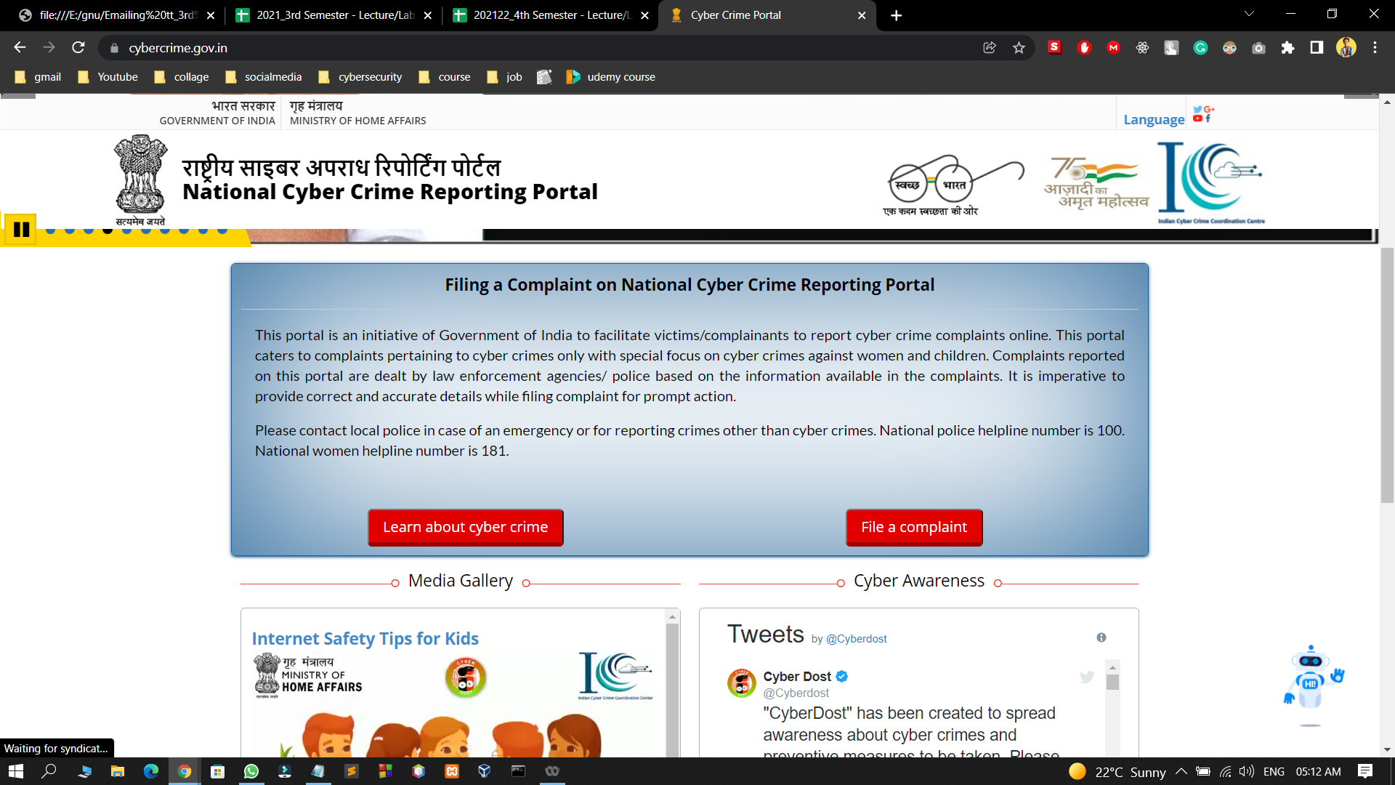
SCOPE:-
This website provides an architectural overview of crime management. This web site is generic. A web-based tool that enables the user to manage the crime on tasks completed as part of a project with tasks and sub-tasks. The tool includes interactivity, Functionality, Information will be stored into a database. Administrative and managerial functions will be provided including configuration projects/tasks/subtasks.

Slide 9
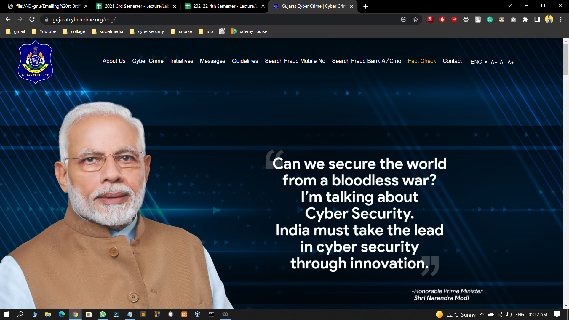
SCOPE:-
This website provides an architectural overview of crime management. This web site is generic. A web-based tool that enables the user to manage the crime on tasks completed as part of a project with tasks and sub-tasks. The tool includes interactivity, Functionality, Information will be stored into a database. Administrative and managerial functions will be provided including configuration projects/tasks/subtasks.

Slide 10
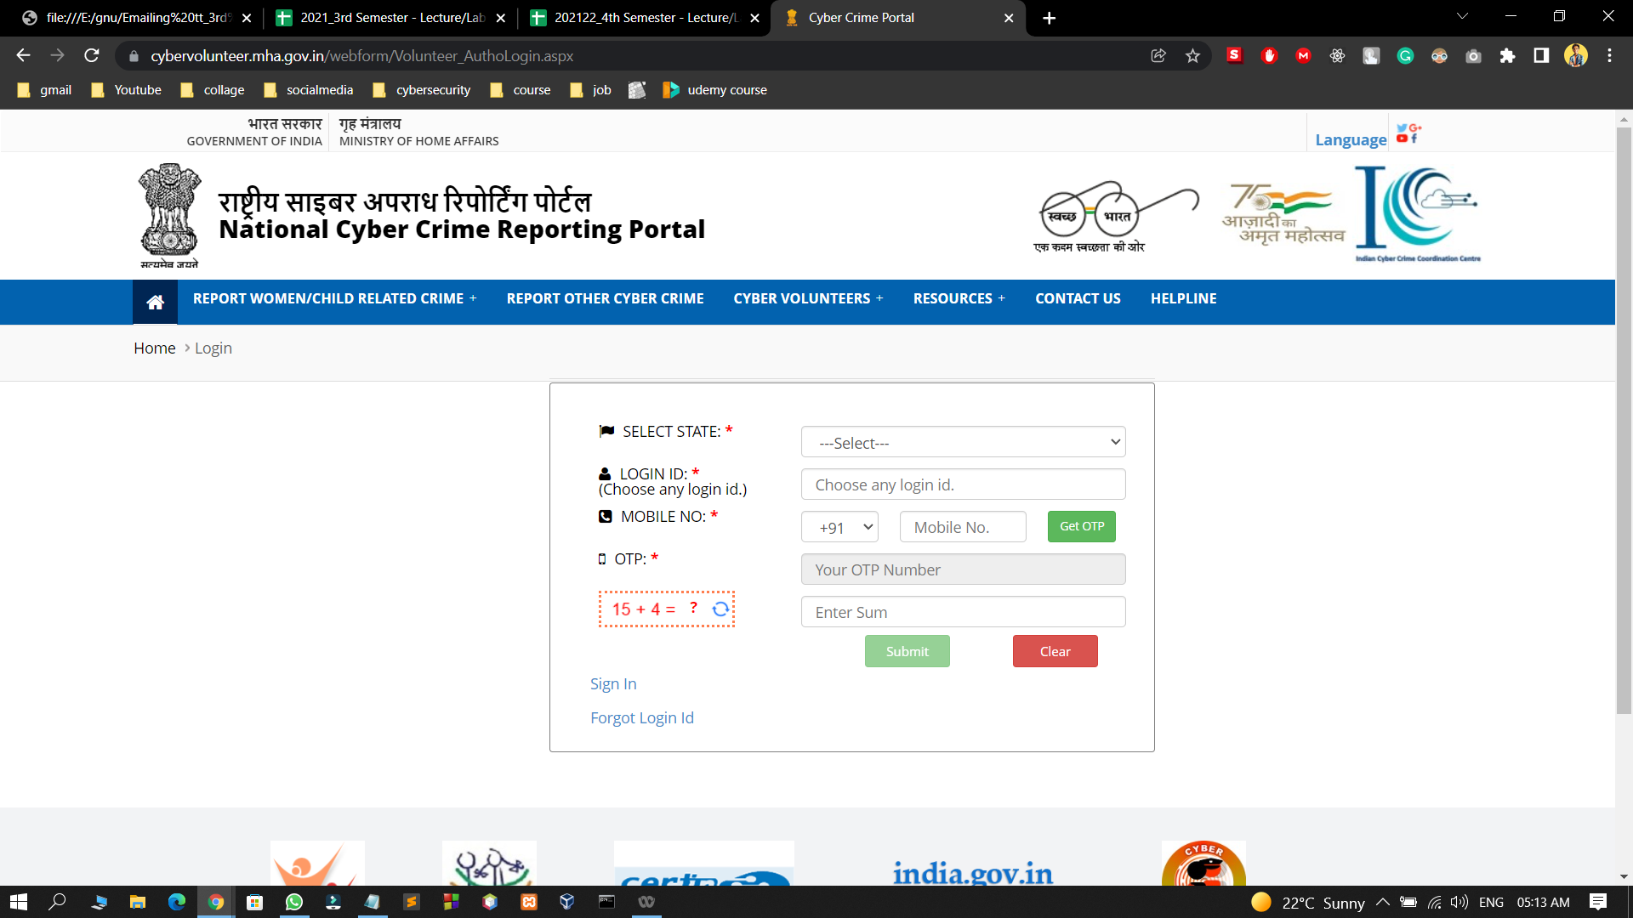

Slide 11
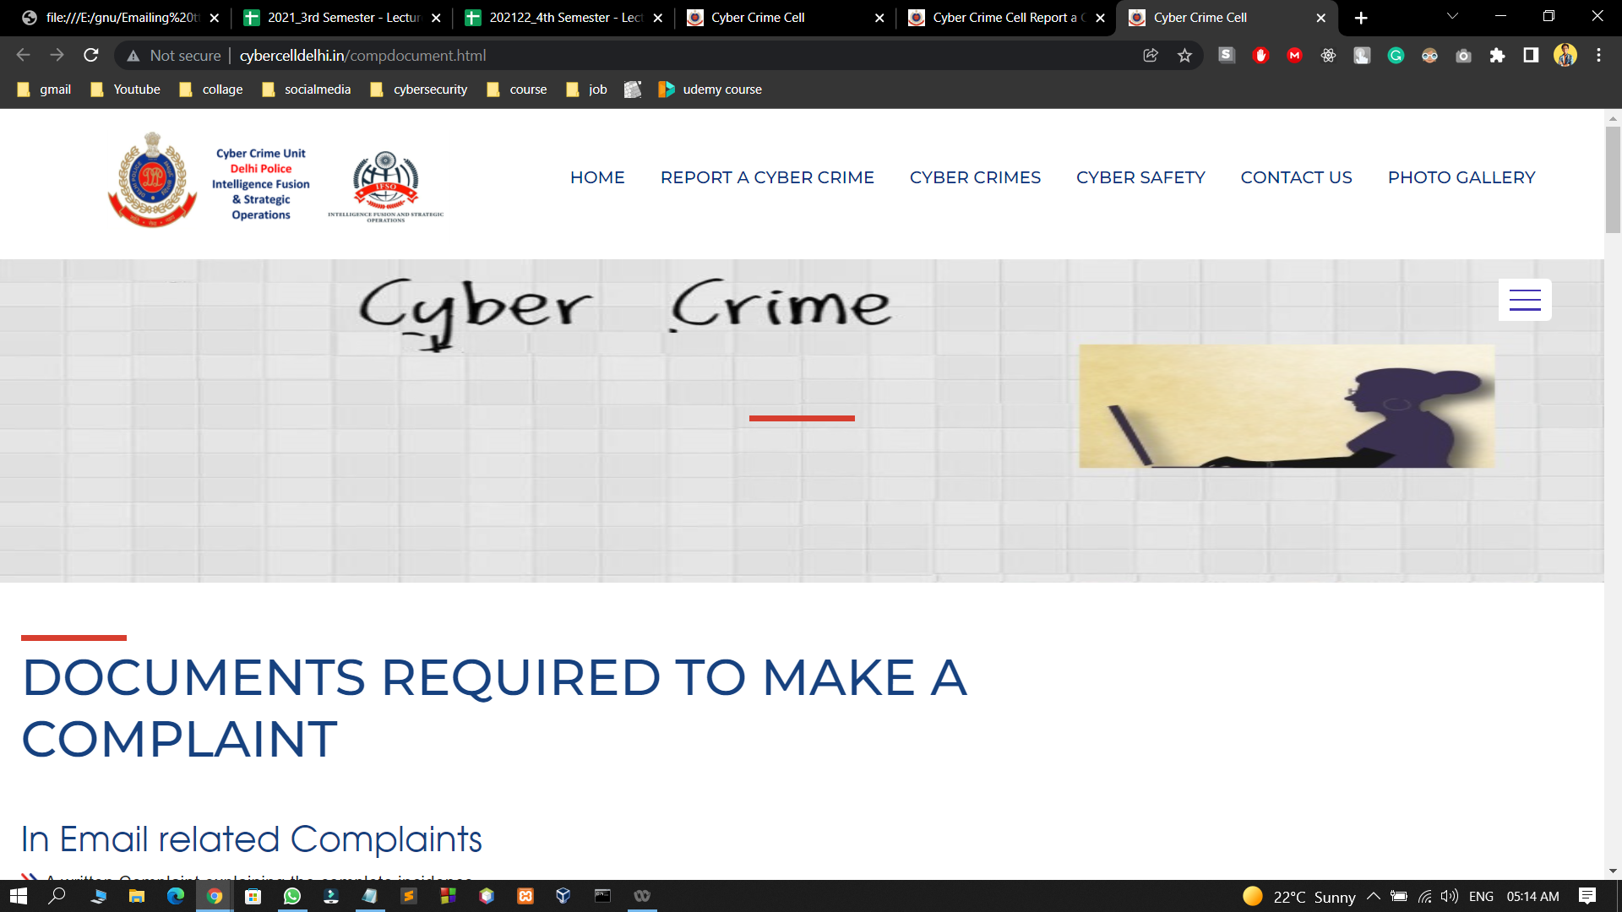

Slide 12
ADMIN FEATURES::-
Add/Update/Display/Delete Police Officer(Police Station)
Add/Update/Display/Delete Citizen(User)
Update/Display/Delete Complaint
View/Delete Complaints Status
View/Delete Emergencey Complaint
View Query
View Feedback

Slide 13
SCOPE:-
This website provides an architectural overview of crime management. This web site is generic. A web-based tool that enables the user to manage the crime on tasks completed as part of a project with tasks and sub-tasks. The tool includes interactivity, Functionality, Information will be stored into a database. Administrative and managerial functions will be provided including configuration projects/tasks/subtasks.

Slide 14
CONCLUSION:-
In the modern world, the use of computers and Mobile phones are becoming rampant. More so, recent developments in ICT Industries has revolutionized and consequently brought about a paradigm shift in the way activities are accomplished. As a result of the crime reporting system needs to embrace these new technologies. This report has presented a simple, convenient, cost-effective, but efficient online crime reporting system with a user-friendly, sensitive and intelligible web interface. Whereby it can be accessed at any time provided there is an internet connection.

